Slide 1
UCLA Dining Log
William Huang, Maggie Li, Ryan Nguyen,
Rohan Srivastava, Tracy Zhao

Slide 2
Project Description
Created a web page that provides food recommendations from UCLA Dining Halls based on caloric intake and allergen information.

Slide 3
Project Demo

Slide 4
Features

Slide 5
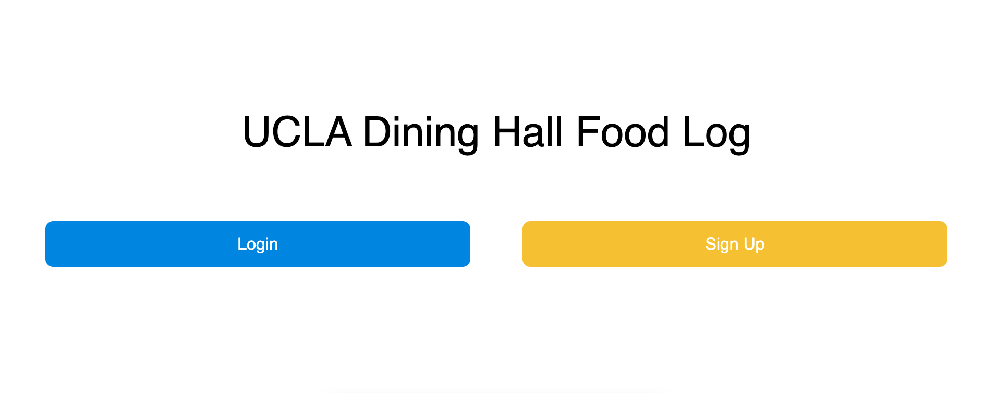
Login/Signup Page
Users can create their own personalized account to save their history and dietary restrictions.
Notes:
User’s land on a Login/Signup Page.
Enter profile information (allergies, daily caloric intake) upon signup.
Profile data sent to MongoDB collection.

Slide 6
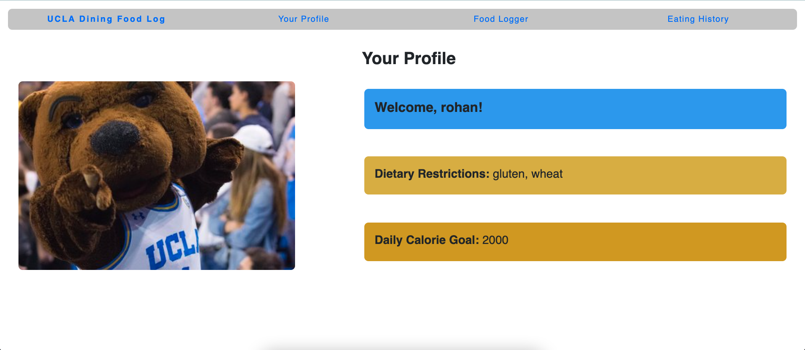
Profile Page
Users can create their own profile to document and look back on their nutrition history, stored in backend database.
Notes:
Users can view history which will query the database for their username and display all meals they’ve eaten on certain dates.

Slide 7
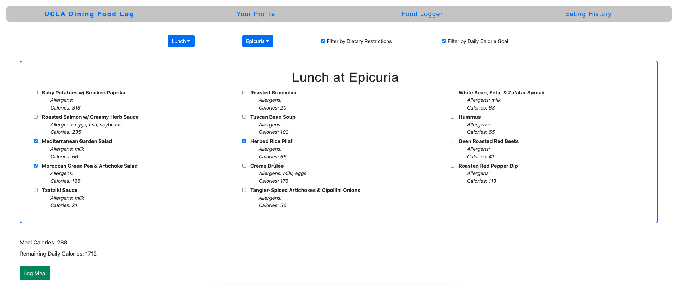
Food Filtering
Users can enter their daily caloric limit along with a list of allergens to better filter their dining options.
Server-side search of menu data to plan meals.
Notes:
Users can select meal period and Dining Hall, this queries through list of food in backend, and returned list of food gets dynamically displayed.
Logging the meal will go through the server and to user’s unique profile in MongoDB.

Slide 8
Dynamic Updating
List of available dining options dynamically updates when specific filters are selected.

Slide 9
Project and Code Design

Slide 10
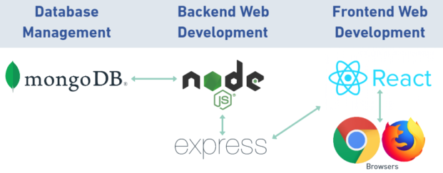
MERN Stack
Notes:
MongoDB used to store all the web scraped food data from UCLA Dining, list of user profiles, and users’ meal histories.
Express used to handle HTTP requests and URL routing.
Node.js runs the server that the web application is running on.
React.js is the JavaScript framework that creates the dynamic front-end of the web page.

Slide 11
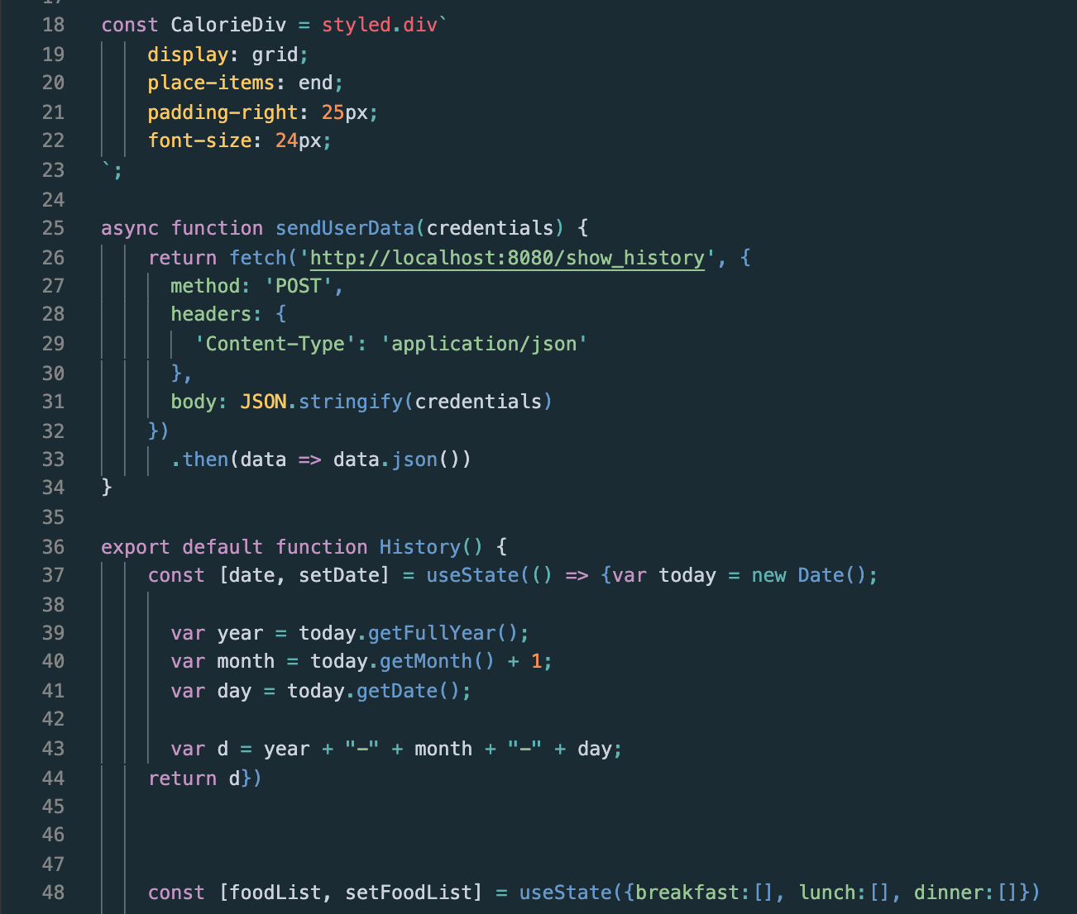

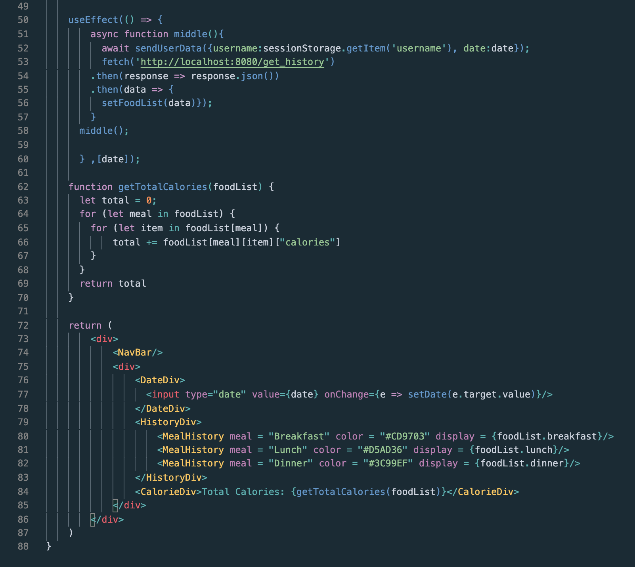
Frontend Project Structure
Components are used to display items onto the screen. Module and templates are used to communicate with the backend.

Slide 12
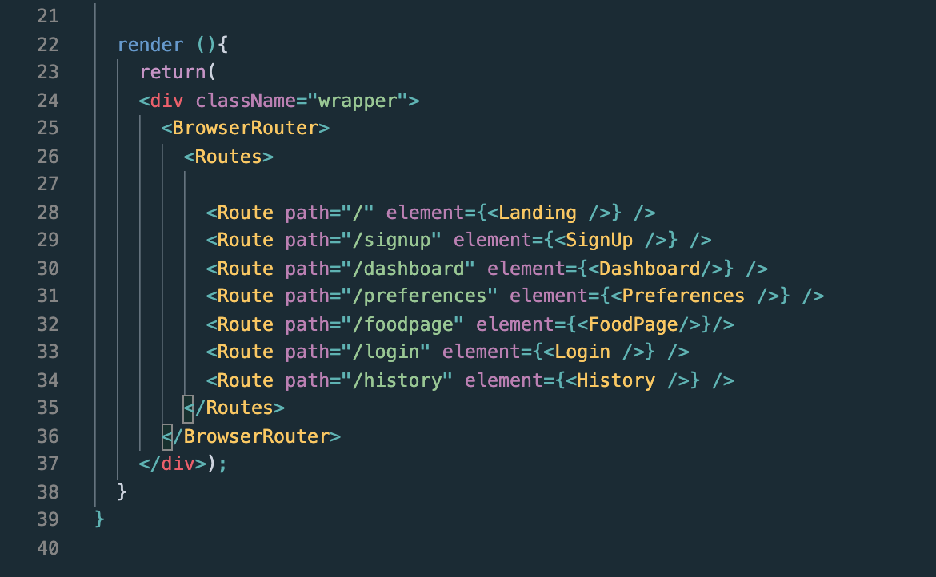
Routing Module
BrowserRouter is a React Router that uses the HTML5 history API to keep UI in sync with the URL. Each URL corresponds to a different page of the website.

Slide 13
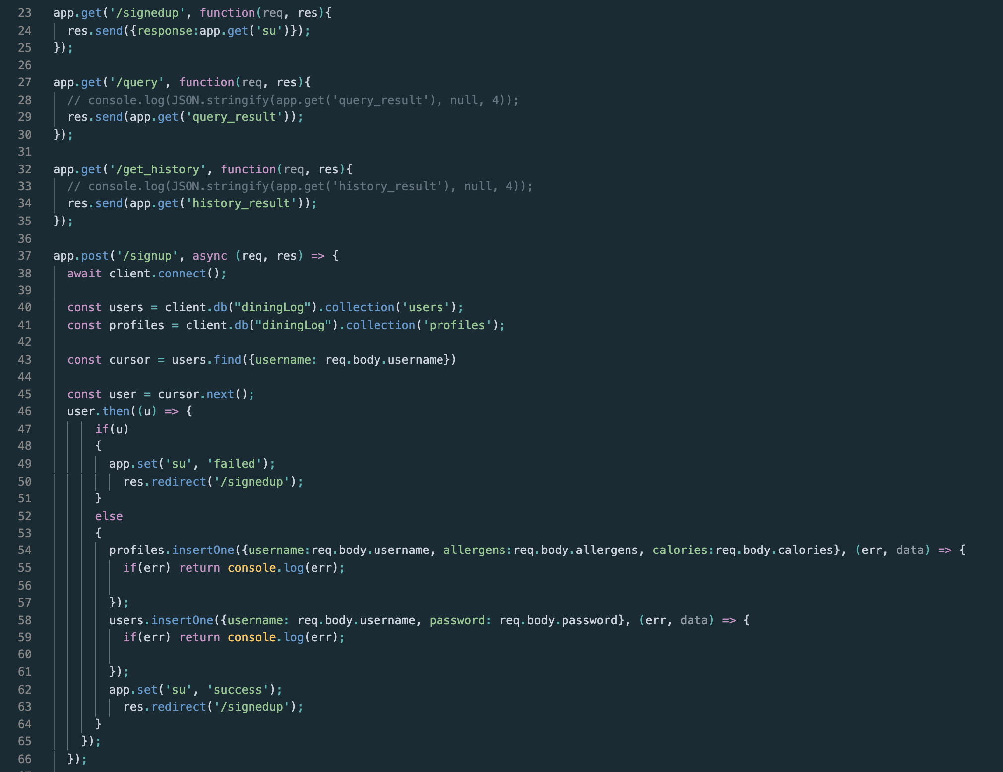
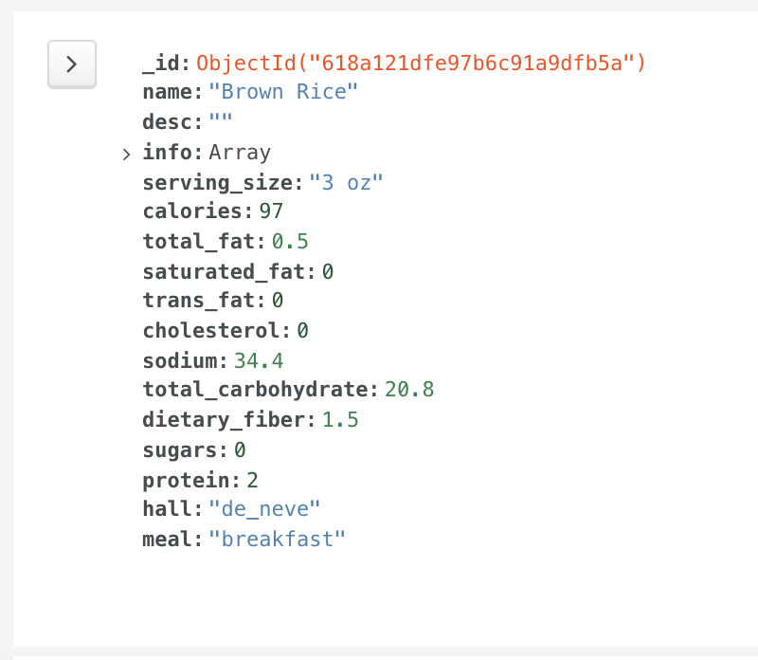
Backend Project Structure
MongoDB contains all food data scraped from UCLA Dining along with users’ profiles and history. Most of backend is structured around interacting with MongoDB, adding/querying through collections.

Slide 14
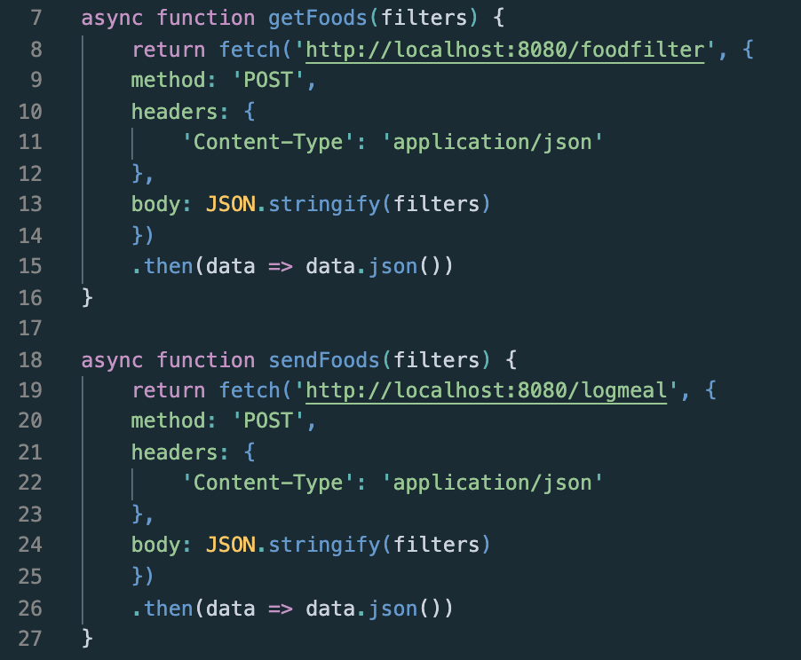
HTTP Requests
HTTP post requests are sent through the server to the backend to get data from MongoDB. Fetch requests collect that data and display it to the frontend.

Slide 15
Difficulties

Slide 16
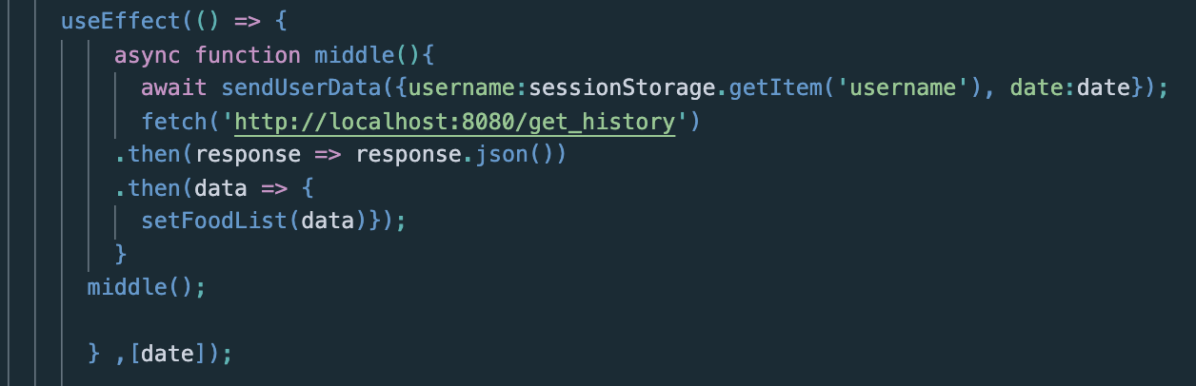
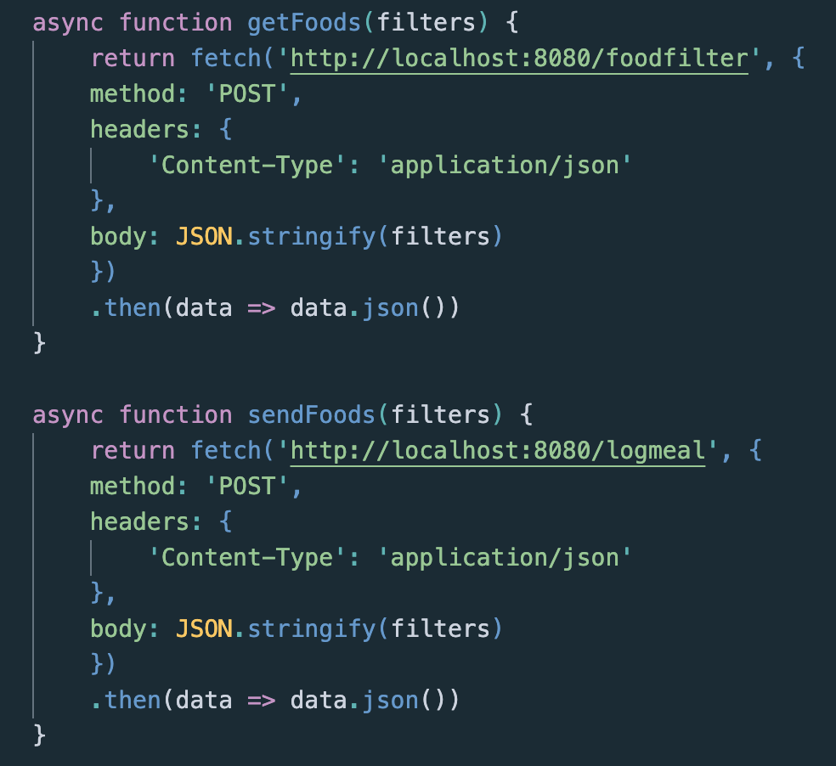
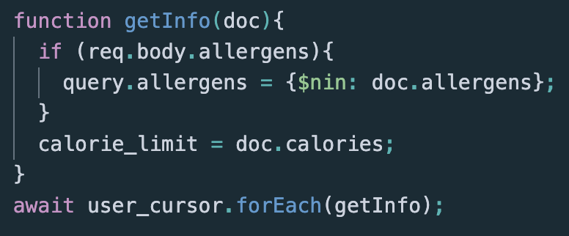
Async and Await
Dealing with any HTTP request or MongoDB required going through an asynchronous function before the data was returned. These requests would need to be resolved with either “await” or “.then()”.

Slide 17
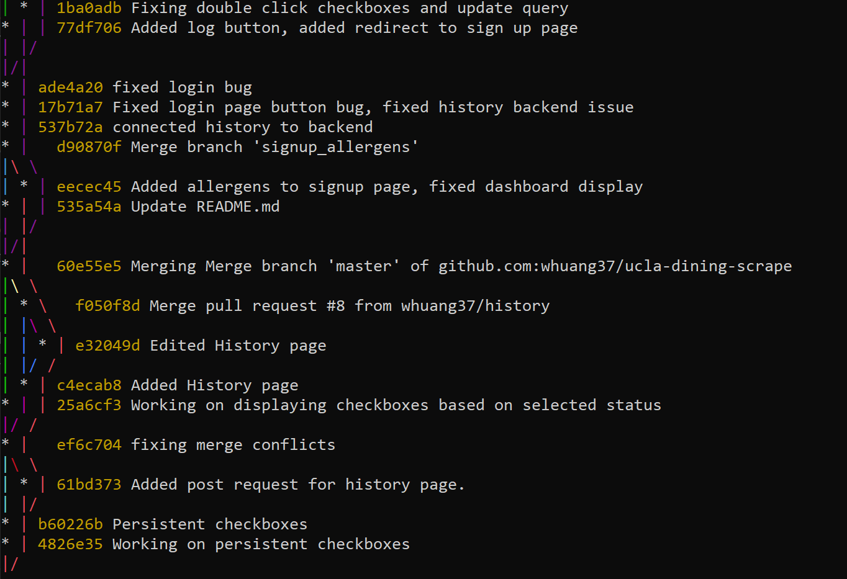
Git Organization

Slide 18
Acknowledgement
The UCLA Dining Log Team would like to extend our sincerest appreciation to Professor Eggert and the CS35L staff for all their assistance throughout this project and the entire quarter.

Slide 19
Thank you!

